Slide 1
LOAN APPROVAL PREDICTION USING ARTIFICIAL NEURAL NETWORKS (ANN)
PRESENTED BY: CHINTHAPATLA ESWAR SAI
REGISTER NO: 211521104028
DEPARTMENT: COMPUTER SCIENCE AND ENGINEERING
3/21/2024 Annual Review
1

Slide 2

PROJECT TITLE:
[Grab your reader’s attention with a great quote from the document or use this space to emphasize a key point. To place this text box anywhere on the page, just drag it.]
3
/21/2024 Annual Review 2
LOAN APPROVAL PREDICTION USING ARTIFICIAL NEURAL NETWORKS (ANN)

Slide 3


3/21/2024 Annual Review 3
AGENDA:
Problem Statement
Project Overview
End Users
Solution and Proposition
Key Features
Modelling Approach
Results and Evalution
Conclusion

Slide 4

PROBLEM STATEMENT:
The problem statement revolves around creating a predictive model that can:
Analyze historical loan data to identify patterns and correlations between applicant features and loan approval outcomes.
Utilize these insights to train a machine learning model capable of predicting the likelihood of loan approval for new applicants.
Optimize the model's performance metrics such as accuracy, precision, recall, and F1-score to ensure reliable predictions.
Deploy the trained model into the operational workflow of the financial institution to streamline the loan approval process, reduce manual effort, and enhance decision-making efficiency.
3/21/2024 Annual Review
4

Slide 5

PROJECT OVERVIEW:
The project aims to develop a machine learning-based solution for predicting loan approval outcomes in financial institutions. By leveraging historical loan data and advanced predictive modeling techniques, the system aims to automate and optimize the loan approval process, enhancing efficiency and accuracy while reducing the risk of defaults.
The traditional loan approval process often involves manual assessment, which is time-consuming, subjective, and prone to errors. The project addresses this challenge
by developing a predictive model that can analyze applicant information and historical loan data to predict whether a loan application should be approved or denied.
The project aims to revolutionize the loan approval process by harnessing the power of data and machine learning. By automating decision-making and improving prediction accuracy, the solution has the potential to drive significant business value for f cial institutions while enhancing the overall customer experience.
inan
3
/21/2024 Annual Review
5

Slide 6
WHO ARE THE END USERS?
The end users for loan approval prediction can vary depending on the specific context and the organization implementing the predictive model. However, typically, the following stakeholders are involved:
Loan Officers/Underwriters: These are the primary users directly involved in the loan approval process. They rely on the predictive model to assess the creditworthiness of loan applicants more efficiently and accurately. The model provides insights and recommendations to help them make
informed decisions regarding loan approvals.
Risk Management Teams: Risk management professionals use the loan approval prediction model to evaluate and mitigate the financial risks associated with lending. By identifying high-risk applicants or potential defaults early on, they can implement proactive measures to minimize losses and maintain a healthy loan portfolio.
Senior Management: Executives and senior management within financial institutions utilize loan approval prediction models to monitor key performance indicators (KPIs), assess portfolio health,
and make strategic decisions regarding lending policies, risk tolerance, and resource allocation.
Regulatory Bodies: Regulatory agencies and authorities may also be end users indirectly impacted by loan approval prediction models. These entities may scrutinize the fairness, transparency, and compliance of lending practices, making it essential for financial institutions to
demonstrate the reliability and fairness of their predictive models.
3/21/2024 Annual Review
6

Slide 7
YOUR SOLUTION AND ITS VALUE PROPOSITION
Solution: Implementing a loan approval prediction model automates the decision-making process, reducing the time and effort required for manual assessments.
Value: Increases operational efficiency by streamlining loan approval workflows, allowing financial institutions to
process loan applications faster and serve more customers within shorter timeframes. Risk Mitigation:
Solution: The predictive model identifies high-risk loan applicants and predicts the likelihood of default based on historical data and applicant features.
Value: Enables proactive risk management by flagging potential defaults early, allowing institutions to adjust lending criteria, set appropriate interest rates, or offer alternative financial products to mitigate losses.
Improved Accuracy and Consistency:
Solution: Utilizing machine learning algorithms ensures consistent and objective evaluation of loan applications, minimizing human bias and errors.
3
/21/2024 Annual Review
7

Slide 8

THE WOW IN YOUR SOLUTION
Machine Learning Models:
  Utilize machine learning algorithms such as logistic regression, decision trees, random forests, gradient boosting, or neural networks to predict loan approval outcomes based on applicant data.
  Train the models on historical loan data containing features such as credit score, income, employment status, debt-to-income ratio, loan amount, and loan purpose.
Feature Engineering:
  Engineer new features or transform existing ones to improve the predictive power of the model.
  Create derived features such as debt-to-income ratio, loan-to-income ratio, or length of credit history to capture additional information relevant to loan approval decisions.
Data Preprocessing:
  Cleanse the dataset by handling missing values, outliers, and inconsistencies.
  Normalize or scale numerical features to ensure uniformity and improve model performance.
  Encode categorical variables using techniques such as one-hot encoding or label encoding to make them suitable for modeling.
Cross-Validation and Hyperparameter Tuning:
  Employ cross-validation techniques such as k-fold cross-validation to assess model performance and reduce overfitting.
  Tune hyperparameters of the machine learning algorithms to optimize model performance and generalization ability.
3/21/2024 Annual Review
8

Slide 9
3
/21/2024 Annual Review
9

Slide 10
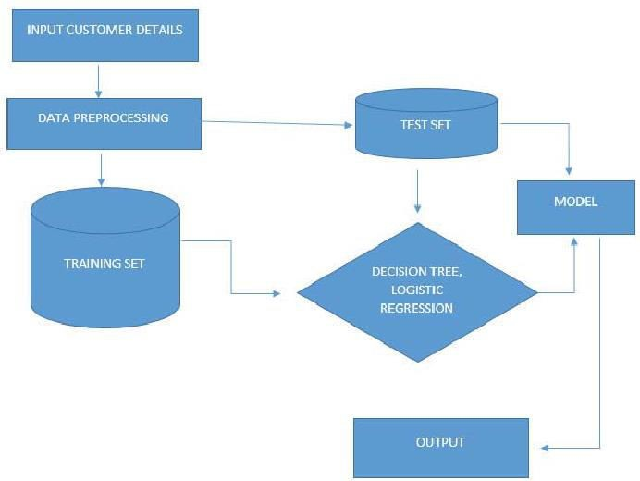
MODELLING
3/21/2024 Annual Review
10

Slide 11
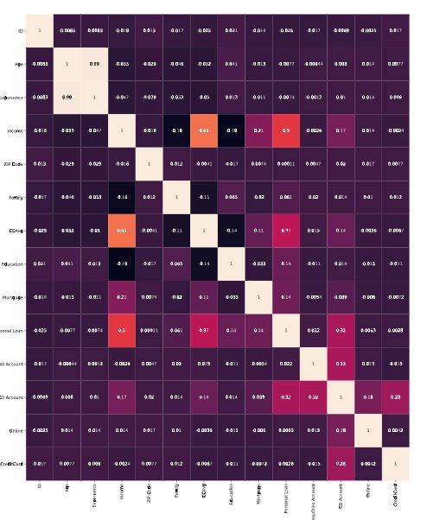
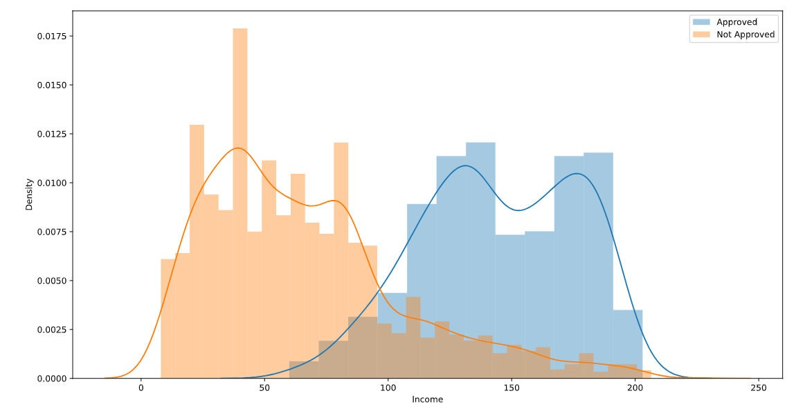
RESULTS
3
/21/2024 Annual Review
11

Slide 12
Demo Link:
https://github.com/Eswarsaichintapatla/LOAN-APPROVAL-PREDICTION.git
3/21/2024 Annual Review
12

